Slide 1
On the need for time series data mining benchmarks: A survey and empirical demonstration
报告人：Jorfun

Slide 2
Introduction
Researches about mining time series data
indexing (speed)
classification, clustering (accuracy)
segmentation (model accuracy)
Much of the work in the literature suffers from two types of experimental flaws, implementation bias and data bias. Because of these flaws, much of the work has very little generalizability to real world problems.
Goal: Demonstrate that empirical evaluations in the past have often been inadequate. Encourage more extensive experimental evaluations in the future.

Slide 3
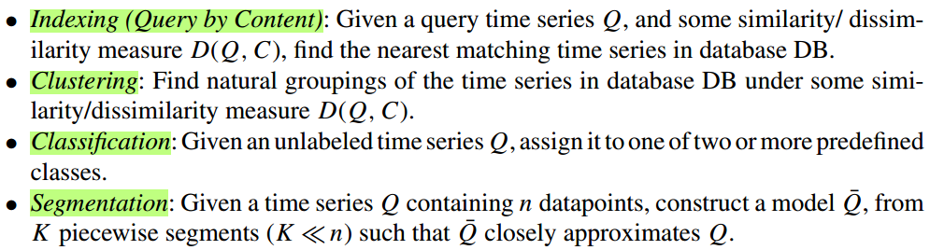
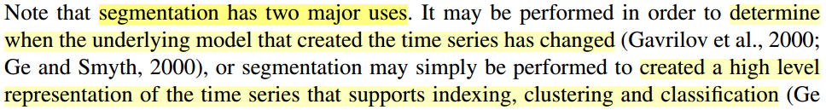
Introduction
For concreteness we begin by defining the various tasks that occupy the attention of most time series data mining research.

Slide 4
Survey
Re-implementing the contribution of more than 25 papers and testing them on 50 real word datasets.
Preparing the survey we read more than 360 data mining papers. Only included the subset of 57 papers actually referenced in this work. (Was the paper ever referenced? Was the paper published in a conference or journal likely to be read by a data miner?)
In general the papers come from high quality conferences and journals, including (SIG)KDD (11), ICDE (11), VLDB (5), SIGMOD/PODS (5), and CIKM (6).

Slide 5
Survey
Size of test datasets
The median size of the test database was only 10,000 objects. Approximately 89% of the test databases could comfortably fit on a 1.44 Mb floppy disk.
Number of rival methods
The median number is 1 (The average is 0.91), but this number includes very unrealistic strawman.
Example: compare times for an indexing method to sequential scan where both are preformed in main memory. Sequential scan enjoys a tenfold speed up when performed on disk.
The average number of rival similarity measures considered is only 0.97.

Slide 6
Survey
Number of different test datasets
On average, each contribution is tested on 1.85 datasets (1.26 real and 0.59 synthetic). This numbers are astonishingly low when you consider that new machine learning algorithms are typically evaluated on at least a dozen datasets.
The choice of dataset has a huge effect on the performance of time series algorithms.

Slide 7
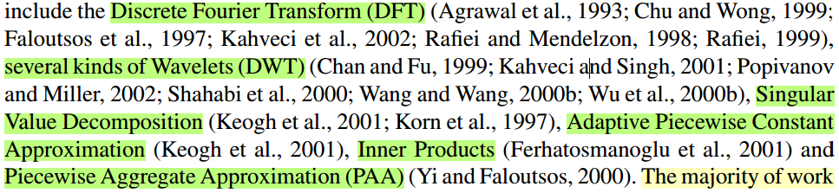
Indexing (query by content)
Similarity search in time series databases has emerged as an area of active interest since the classic first paper by Agrawal et al. (1993). More than 68% of the indexing approaches surveyed here use the original GEMINI framework (Faloutsos et al., 1994), but suggest a different approach to the dimensionality reduction stage.

Slide 8
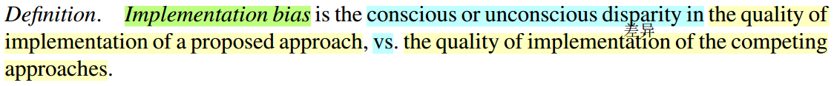
Indexing (query by content)
Implementation bias
Most time series indexing techniques use the same indexing framework, and achieve the claimed speedup solely with the choice of representation, it is important to compare techniques in a manner that is free of implementation bias.
Implementing fairly complex indexing techniques allows many opportunities for implementation bias.

Slide 9
Indexing (query by content)
Implementation bias
Example:
Demonstrate that DWT is superior to DFT with shift-normalized data
(1~N) -> (2~N+1)
neglect doing a similar optimization for DFT
use the simple O(n2) DFT algorithm rather than spend the time to code the more complex O(n Log n) radix 2 algorithm

Slide 10
Indexing (query by content)
Implementation bias
Solution:
Extremely conscientious implementations of all approaches, combined with diligent explanations of the experimental process
Design experiments that are free from the possibility of implementation bias
Since all the exact indexing techniques use the same basic framework, the efficiency of indexing depends only on how well the dimensionality-reduced approximation can model the distances between the original objects.
Tightness of the lower bound can be estimated by random sampling of a dataset.

Slide 11
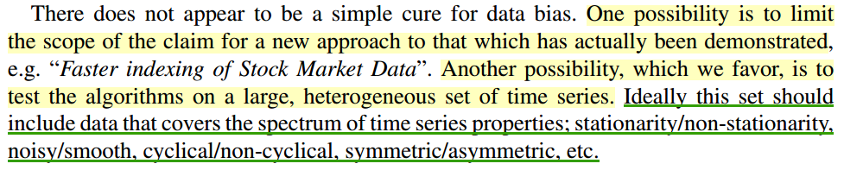
Indexing (query by content)
Data bias
which dataset(s) are sampled?
In fact, the choice of test data has a great effect on the experimental results, and virtually all papers surveyed suffer from data bias.

Slide 12
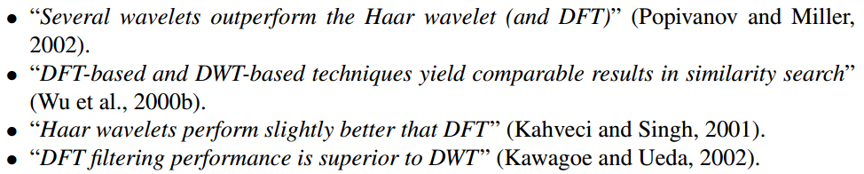
Indexing (query by content)
Empirical demonstration of implementation and data bias
Which to believe?
Because of the problems of implementation bias and the limited number of test datasets we feel little credence can be given to any of the claims.

Slide 13
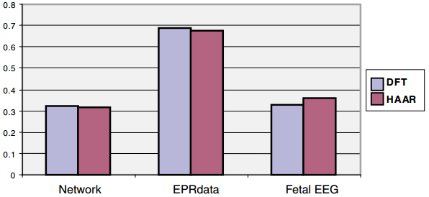
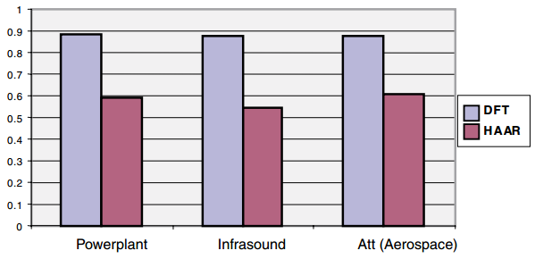
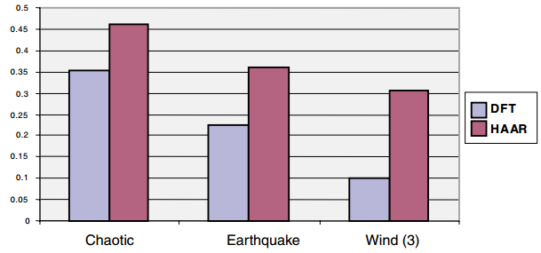
Demonstration of data bias
Papers listed above experimented on a maximum of 3 datasets. If we use that number of datasets we can demonstrate essentially any finding we wish.

Slide 14
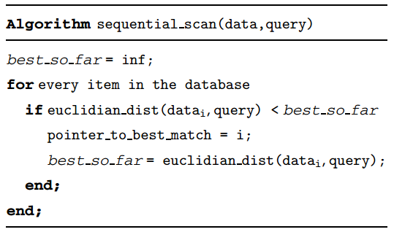
Demonstration of implementation bias
Demonstrate the potential for implementation bias with sequential scanning performed in main memory.
Optimization 1: neglect taking the square root
Optimization 2: comparing the best so far variable to the partial sums at each iteration of the loop.

Slide 15
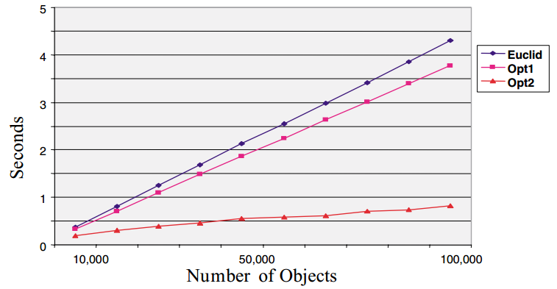
Demonstration of implementation bias
Demonstrate the potential for implementation bias with sequential scanning
performed in main memory.

Slide 16
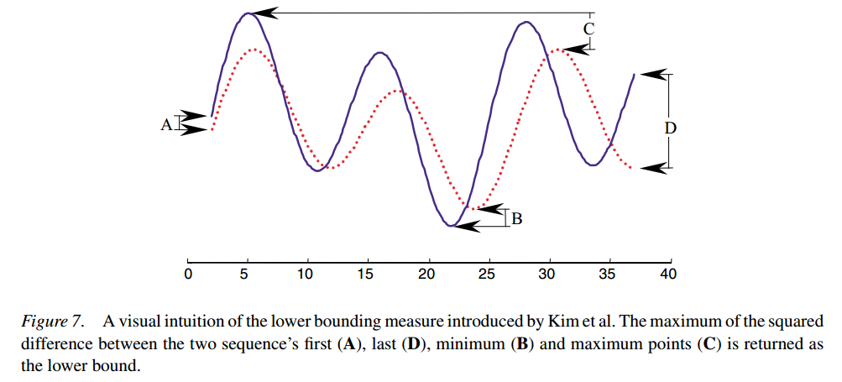
A real world case
a novel linear time lower bounding technique for DTW. Kim et al. (2001)

Slide 17
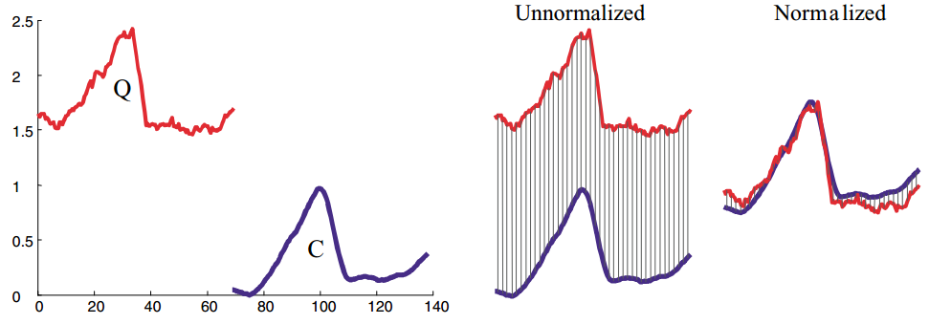
A real world case
Time series appear to have similar shapes, but occur at different offsets in the Y-Axis.

Slide 18
A real world case
The authors report only experiments with no normalization.
If we normalize the data the lower bound becomes extremely weak, a tiny fraction of the true distance, and thus the pruning power of the lower bound is greatly reduced.

Slide 19
Classification and clustering
Most of the contributions focus on providing a new similarity measure as a subroutine to an existing classification or clustering algorithm.
There are two ways to answer this question, subjectively and objectively, we consider both below.

Slide 20
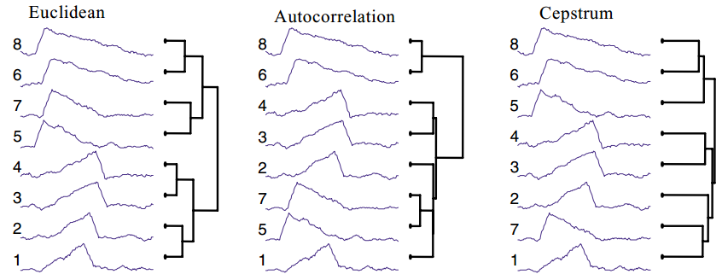
Subjective evaluation of similarity
We believe that one of the best (subjective) ways to evaluate a proposed similarity measure is to use it to create a dendrogram of several time series from the domain of interest (Keogh and Pazzani, 1998).
Moreover, showing some examples of matching time series is of little utility unless some strawman comparison is used.

Slide 21
Objective evaluation of similarity
Given a database of labeled time series, objective measurements of the quality of a proposed similarity measure can be readily obtained by running simple classification experiments. (error rates)

Slide 22
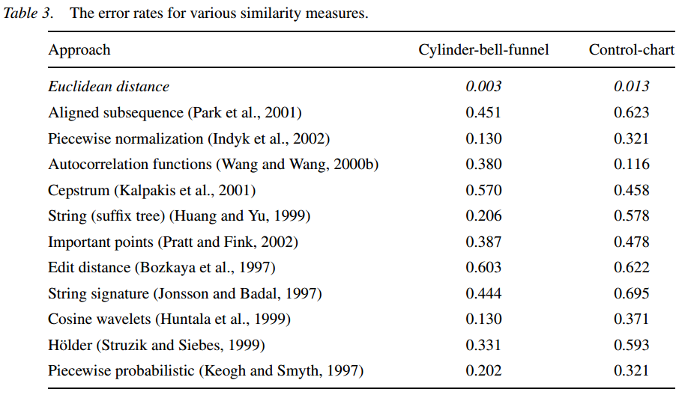
Objective evaluation of similarity

Slide 23
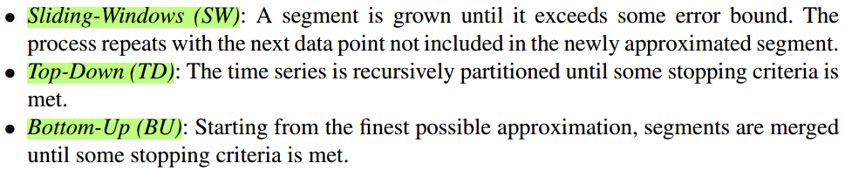
Segmentation
Most time series segmentation algorithms can be grouped into one of the following three categories.
How to measure the quality of a segmentation algorithm?
The reconstruction error is simply the Euclidean distance between the original data and the segmented representation.

Slide 24
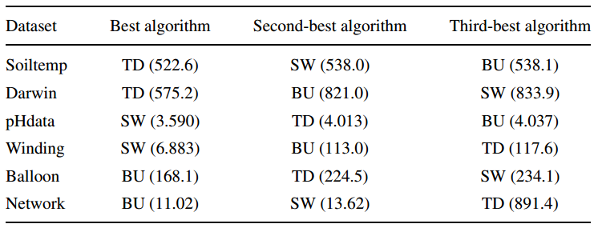
Data bias in segmentation
Given that we have 3 algorithms, want to know which is best.
The papers in the survey that use a segmentation algorithm test on a median of 1 dataset. However, if we use only one dataset we can demonstrate any finding we wish!

Slide 25
Conclusions and recommendations
We conclude this paper with concrete suggestions for researchers working on time series data mining.
Algorithms should be tested on a wide range of datasets, unless the utility of the approach is only been claimed for a particular type of data. If possible, one subset of the datasets should be used to fine tune the approach, then a different subset of the datasets should. be used to do that the actual testing.
Where possible, experiments should be designed to be free of the possibility of implementation bias. Note that this does not preclude the addition of extensive implementation testing.
Novel similarity measures should be compared to simple strawman, such as Euclidian distance or Dynamic Time Warping. Some subjective visualization, or objective experiments should justify their introduction.
Where possible, all data and code used in the experiments should be made freely available to allow independent duplication of findings (Bay, 1999).

Slide 26
感谢聆听

